Slide 1
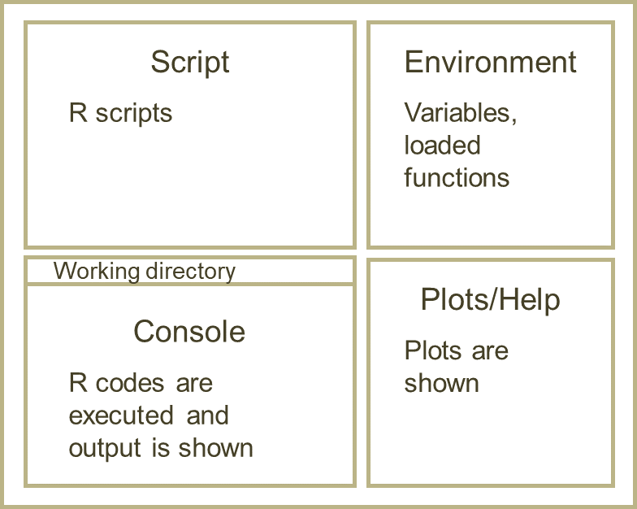
Script
Environment
R scripts
Variables, loaded functions
Working directory
Plots/Help
Console
Plots are shown
R codes are executed and output is shown

Slide 2
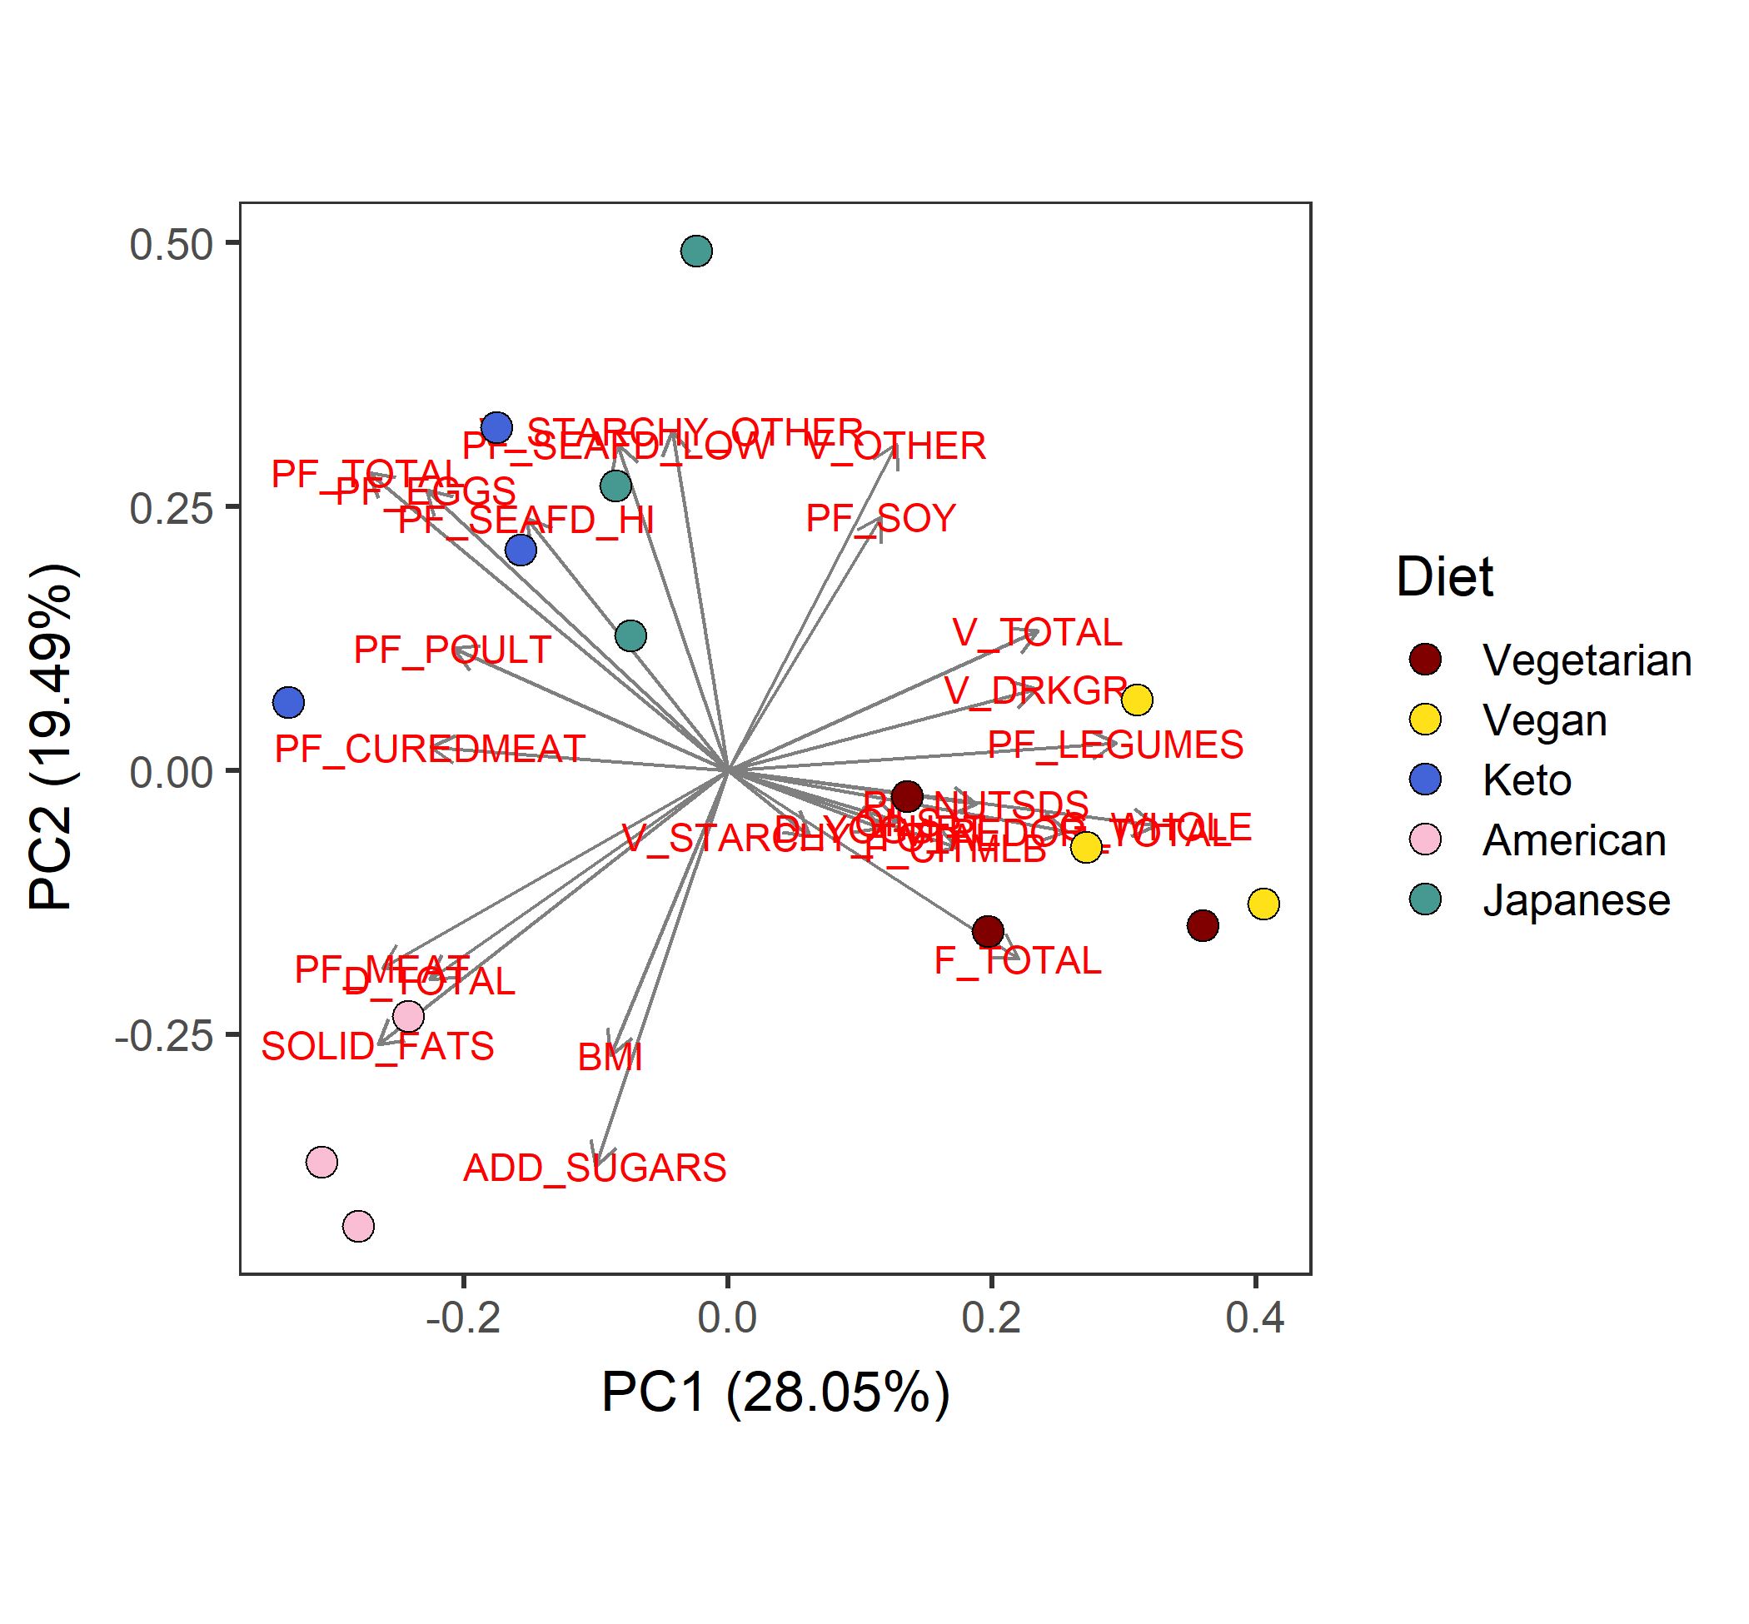
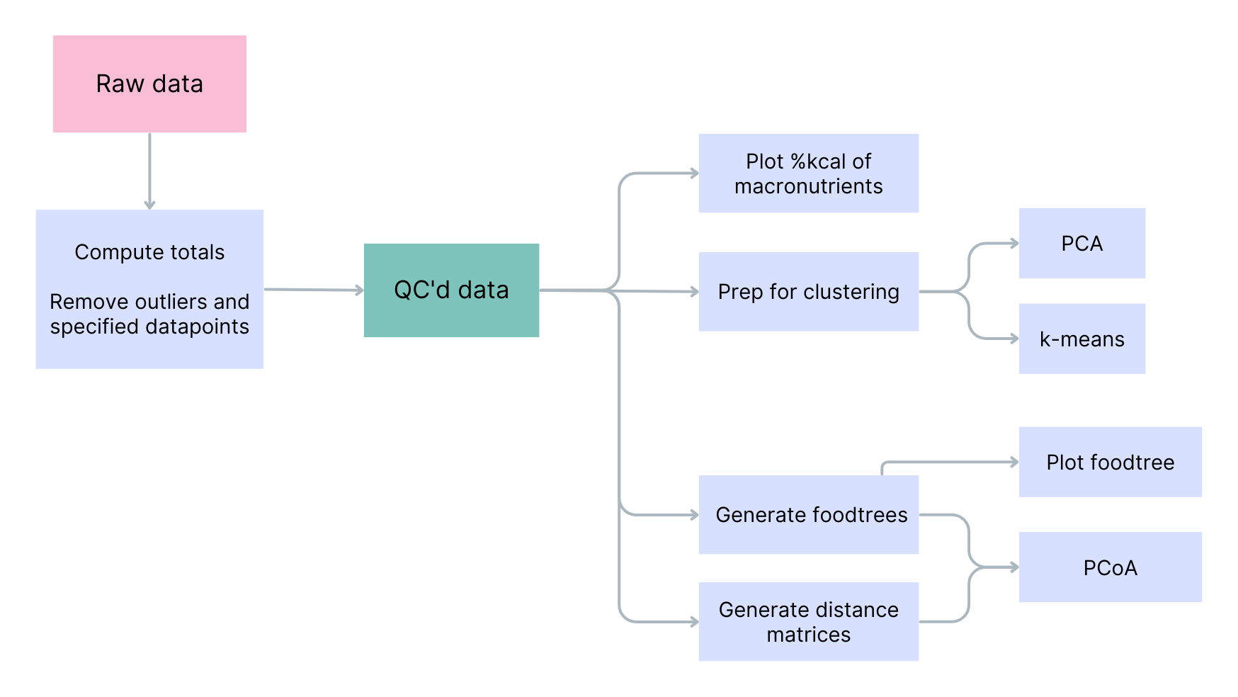
#800000
#FFE119
#4363D8
#FABED4
#469990
Raw data
prcess
QC-ed data

